Slide 1
Capstone project Unleashing Insights from Football Data Using Multiple Tools
Mentor: Munna Pandey
submitted by: S. Pratheek
Wave number:4777
Batch Number:da374S37

Slide 2
Introduction
Football is a global, popular, and dynamic sport with many different factors that can influence the outcome of a match. By analyzing large datasets of football data, teams can gain a deeper understanding of factors that contribute to players' success, enabling coaches, scouts, and analysts to make informed decisions.
Football data analysis is the process of collecting, cleaning, and analyzing data to extract meaningful insights. The valuable insights extracted from this analysis can be used to improve player performance, team tactics, fan engagement, and overall decision-making.
Various data analysis techniques, such as Exploratory Data Analysis (EDA) and correlation, prediction using ML models using tools like Python, MySQL, Excel, and Tableau, can be employed to extract meaningful insights. These insights aim to enhance decision-making, improve team performance, and provide a competitive edge in the sport.
Objective:
This involves data preprocessing, conducting exploratory data analysis, performing descriptive analysis with various data analysis and visualization techniques, predictions using statistical models, and machine learning models. Multiple tools such as Python, MySQL, Tableau, Excel must be used based on requirements of the analyses. The objective of this sprint is to merge multiple data files and preprocess the football dataset for further analysis.

Slide 3
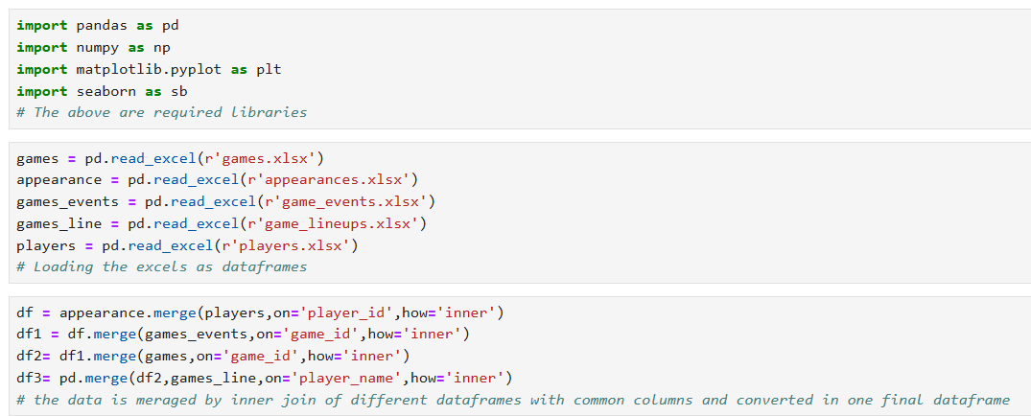
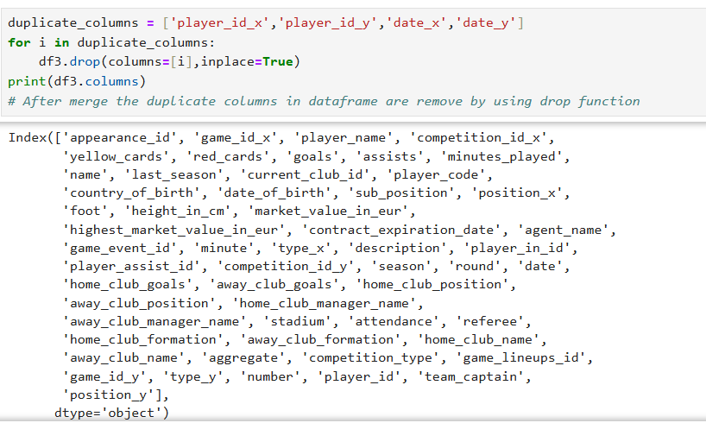
Data preprocessing
Removing duplicate rows

Slide 4
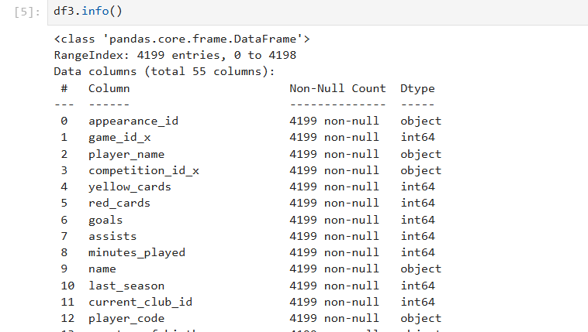
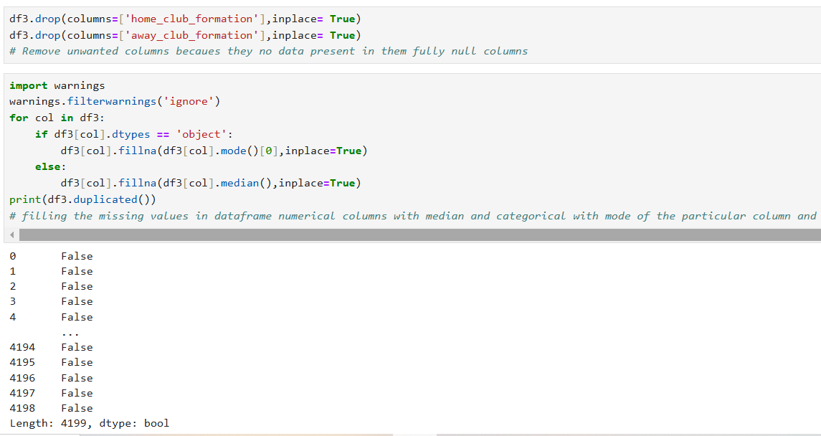
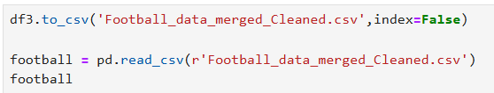
.
Interpretation: filling the missing values in data frame numerical columns with median and categorical with mode of the particular column and no duplicated values in df3. Saved our final cleaned data set to csv file call football merged and cleaned file

Slide 5
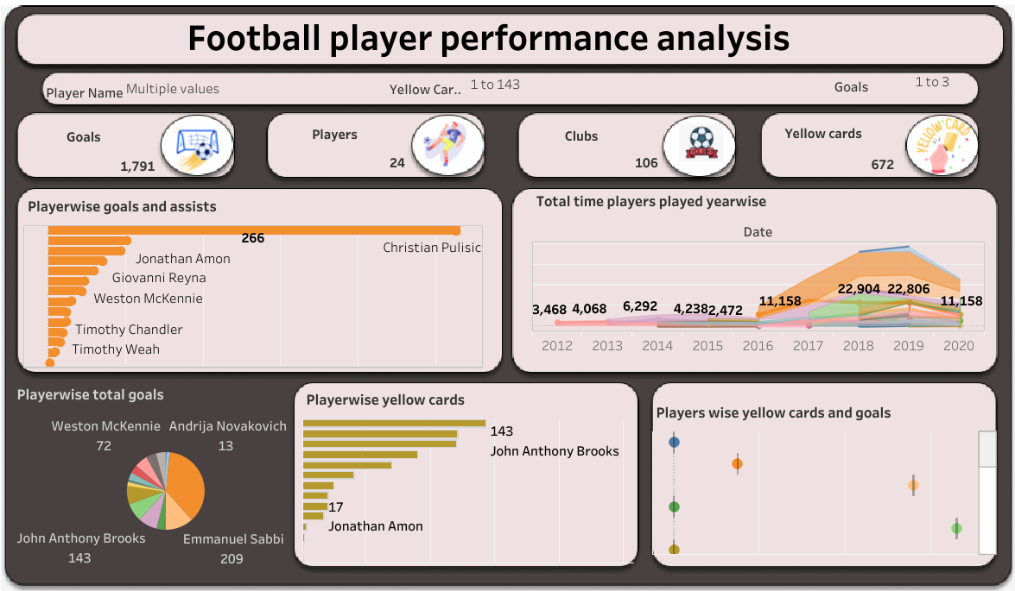
Performance Analysis
Interpretation:
The playername common filter for each visualizations ,Christian Pulisic has most and high number of goals Andrija Novakovich has least goals .Christiancappis has high minutes players all others players each year,john anthony brooks, Timothy chandler have low minutes played in 2016.John Anthony brooks has high number of yellow cards,john Sargent, Terrence Boyd, Lynden Gooch, Desevio Payne had low number of yellow cards. players with high yellow ards have more goals. Players with zero goals have less yellow cards or sometimes no yellow cards players with more goals have yellow cards.

Slide 6
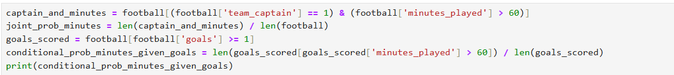

What is the probability of a player being both a team captain and scoring a goal in a match?
Output: 0.0
Interpretation: The probability of a player being both a team captain and scoring a goal in a match is 0.0.There might not be any players in the dataset who were team captains and scored goals in the same match.
What is the probability that a player is a team captain and played more than 60 minutes in a match?
Output: 0.8012
Interpretation: Player scored at least one goal, the probability that they played more than 60 minutes is 0.8012

Slide 7
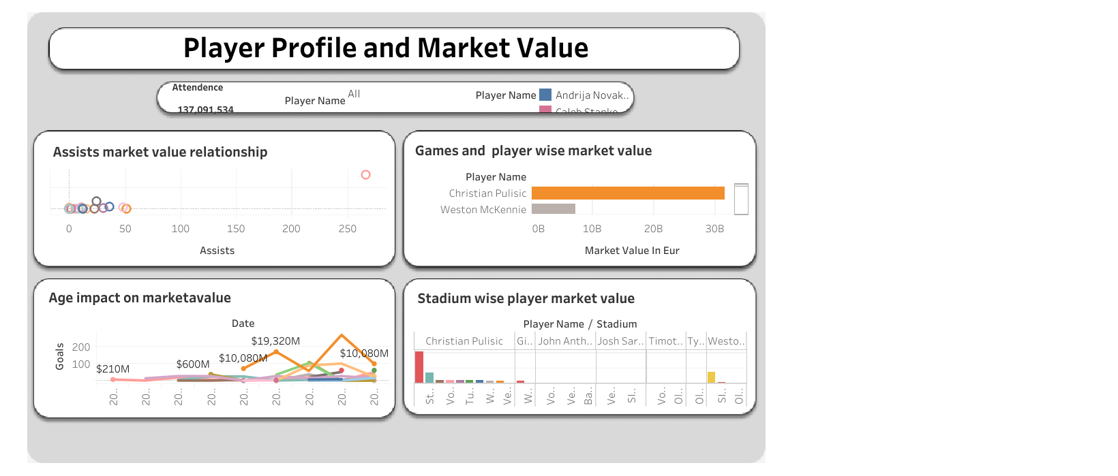
Player Profile and Market Value
Interpretation:
There is a positive correlation between assists and players' market value. Christian Pulisic leads with high game events and market value, followed by Weston McKennie. Lynden Gooch has the lowest game events and market value. In 2019, Pulisic had the highest market value, while 2018 showed a lower trend. Market value depends more on goals than game experience, as seen with players like Weston McKennie, whose value rises with goals. Pulisic has played in many stadiums, whereas Giovanni Reyna has played in fewer.

Slide 8
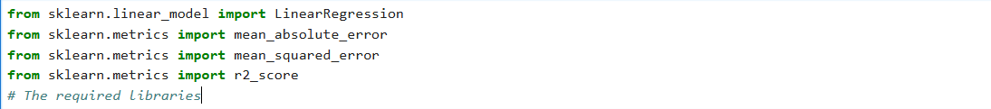
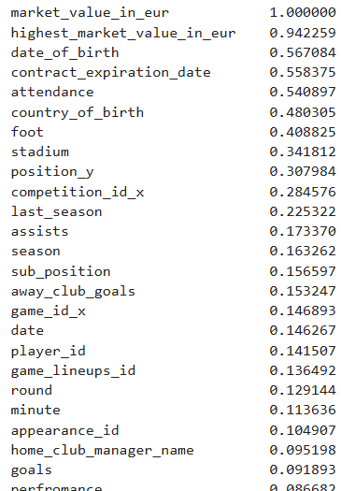
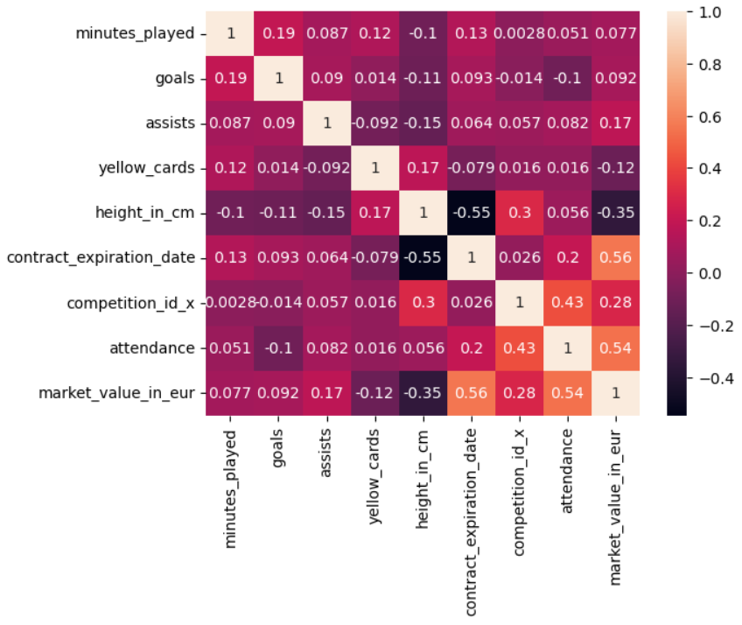
How do player attributes correlate with their market value using multilinear regression?

Slide 9
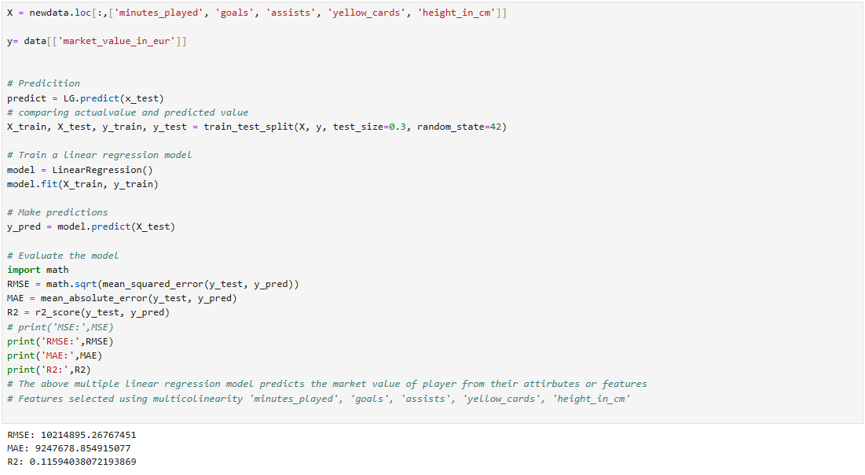
.
Output:
RMSE: 3675660.63
MAE: 2550414.01
R2: 0.89
Interpretation:
The above multiple linear regression model predicts the market value of player from their attributes or features. Features selected using multicollinearity , 'minutes played', 'goals', 'assists', 'yellow cards', 'height_in_cm'

Slide 10
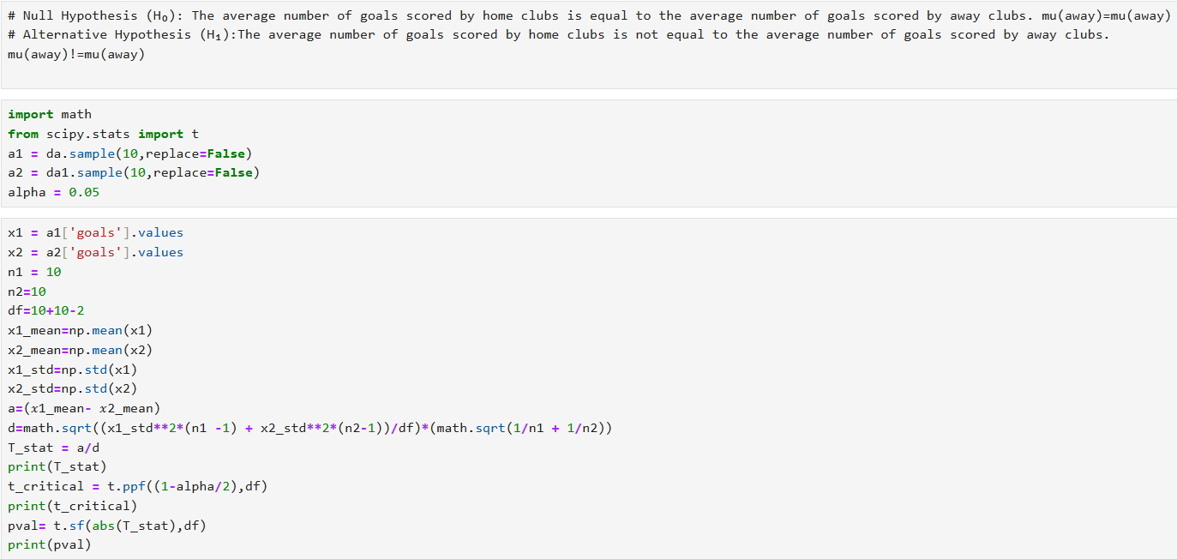

Team Comparison
Is there a significant difference in the average number of goals scored by home clubs compared to away clubs?
Output:
0.8918246571152398
2.10092204024096
0.19212701715797847
Accept null hypothesis
Interpretation:
The above two tailed test is performed as the sample size was less than 30 and pval is less then alpha so null hypothesis is accepted

Slide 11
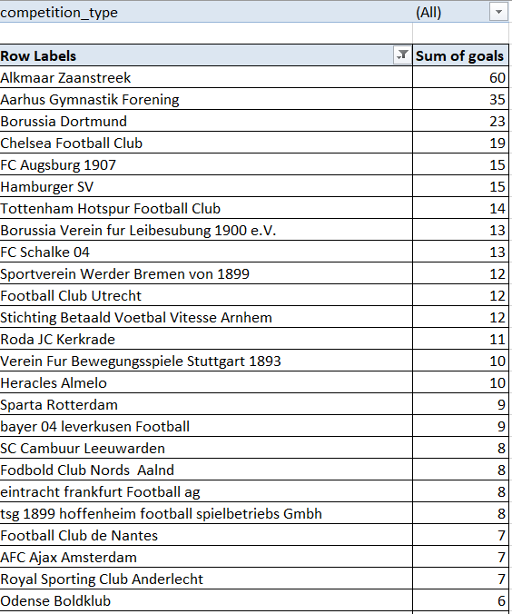
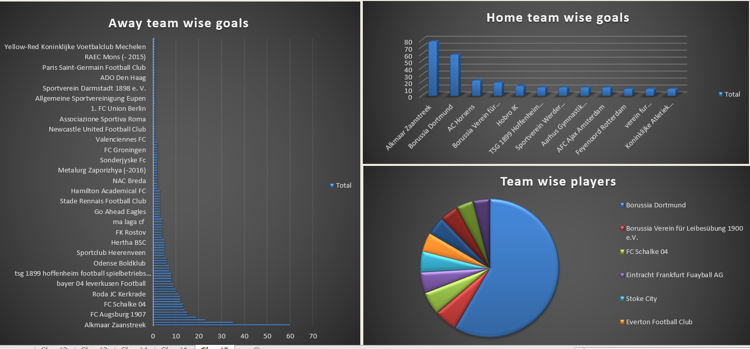
Team Comparison
Interpretation:
Alkmaar zaanstrek team has high number of home clubs' goals, away club goals in domestic league.
Tottenham Hotspur Football Club team has high number of home clubs goals, away club goals in international matches
Borussia Dortmund has high number of players

Slide 12
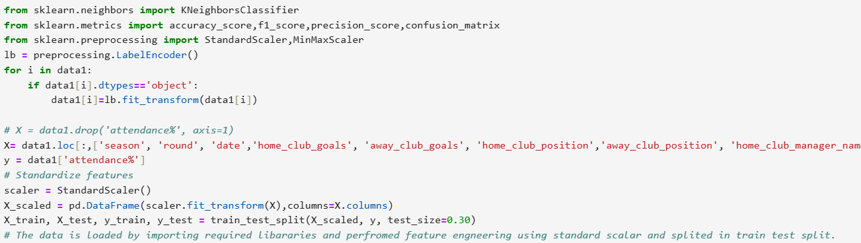
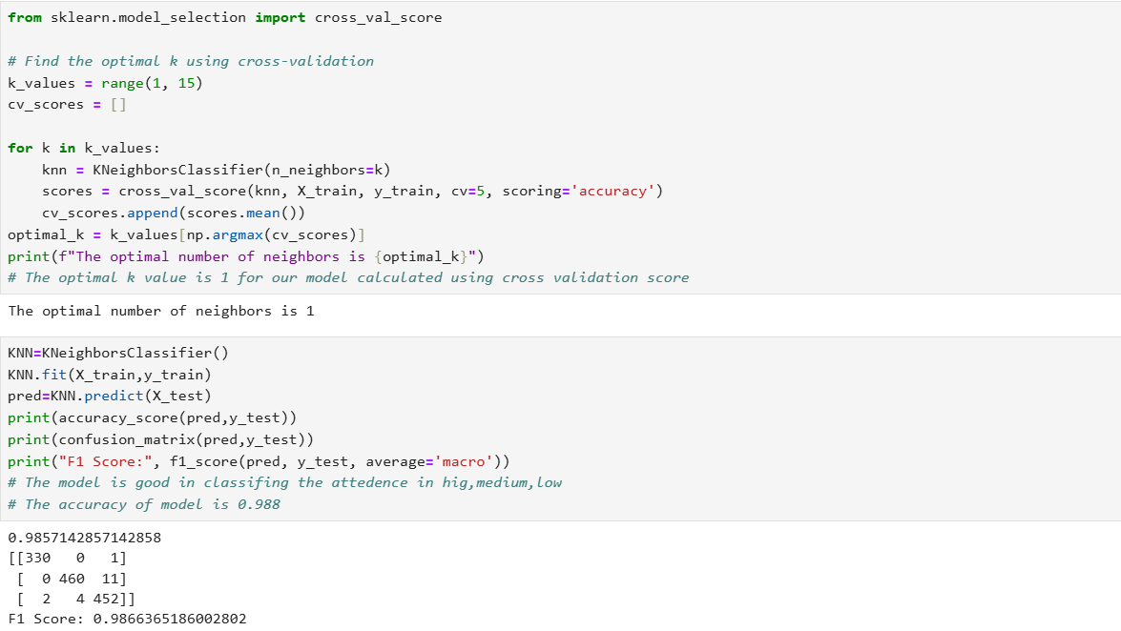
How can KNN classification be used to classify stadium attendance levels (high, medium, low) based on match-specific, team-related, and external factors?
Output:
The optimal number of neighbors is 1
0.9857142857142858
[[330 0 1]
[ 0 460 11]
[ 2 4 452]]
F1 Score: 0.9866365186002802
Interpretation: The knn classification model is good in classifying the attendance in hig, medium, low .The accuracy of model is 0.988

Slide 13
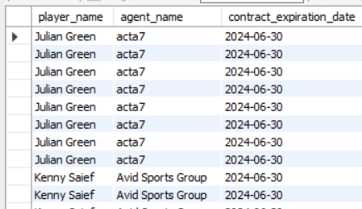
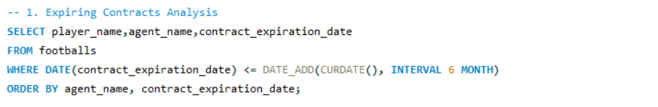
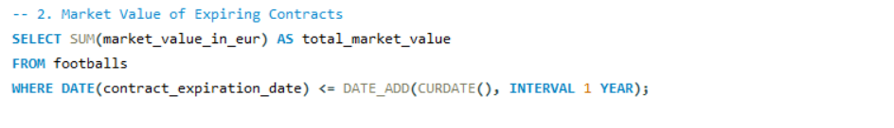

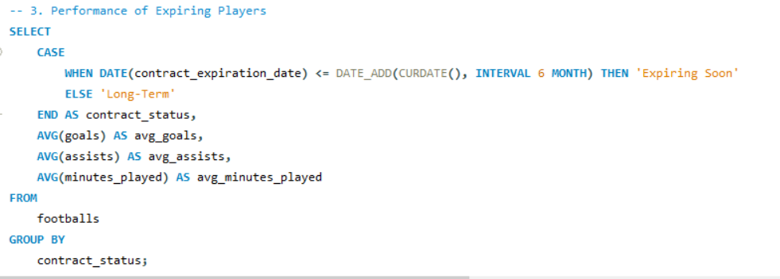

Contract management
Interpretation:
The avg goals of expiring soon is 0.1048 and long trem players is 0.4975.

Slide 14
Summary
Missing numerical values were filled with the median, categorical values with the mode, and duplicates were removed. Final dataset saved as "football_merged_and_cleaned.csv".
Christian Pulisic leads with the highest goals and market value, peaking in 2019, and played in the most stadiums.
Andrija Novakovich scored the least goals, while Christian Cappis played the most minutes annually.
John Anthony Brooks and Timothy Chandler played the least minutes in 2016.
John Anthony Brooks received the highest number of yellow cards, and players with high yellow cards tend to have more goals.
There is no difference in mean of goals in come and way club’s
Players with no goals usually have no or fewer yellow cards.
Probability of a player being both a team captain and scoring a goal is 0.0, while the probability of playing more than 60 minutes after scoring is 0.8012.
Goals follow a normal distribution, supporting the Central Limit Theorem.
Logistic regression using home goals, market value, and attendance achieved an accuracy of 65%.
Market value positively correlates with assists, and Borussia Dortmund leads in players and market value across competitions.
Signal Iduna Park hosts players with the highest market value, while Chelsea has only one player in some categories.
Felix issued the most yellow cards, and referees hosting more matches tend to give more yellow cards.
Substitution trends show attack positions dominate, with right winger having the most substitutes and center forward the least.
K-Means clustering grouped players into four performance categories based on goals and assists.
Domestic leagues have the most stadiums, and L1 competitions recorded the highest goals.

Slide 15
Conclusion
Player Performance: Christian Pulisic's high goal-scoring and market value make him a standout player for endorsements and team leadership roles.
Player Utilization: Christian Cappis’s consistently high minutes played highlights his importance to team strategy, while John Anthony Brooks and Timothy Chandler’s low minutes in 2016 may indicate reduced utility during that season.
Discipline and Goals: Players with more yellow cards tend to score more goals, suggesting a trade-off between aggressive play and performance. This insight can guide team selection and coaching strategies.
Captaincy and Goals: The absence of players who are both captains and goal scorers in matches may indicate a need to reassess leadership roles to maximize contributions.
Game Time and Scoring: Players who score goals are likely to play more than 60 minutes, emphasizing the need to retain high performers in longer matches.
Market Value Drivers: Market value correlates more with goals and assists than game experience, suggesting clubs should prioritize performance over tenure when negotiating contracts.
Team Strength: Borussia Dortmund leads in player market value and participation, reinforcing its dominance in domestic and international competitions.
Referee Impact: Referees hosting more matches issue more yellow cards, indicating potential biases or stricter enforcement of rules in high-attendance games.
Substitution Trends: Right wingers are substituted most often, showing their strategic role, while center forwards are substituted the least, indicating their critical importance in matches.
Competition Analysis: Domestic leagues offer more opportunities for players and generate higher goals, while competitions like L1 demonstrate exceptional scoring trends.
Player Segmentation: K-means clustering effectively categorizes players based on performance, helping clubs identify and target top-performing players for recruitment or retention.
Stadium Insights: Signal Iduna Park’s hosting of high-value players suggests a lucrative venue for sponsors and events.
Team Performance: Players like John Anthony Brooks excel in domestic competitions, indicating potential for focused development in local leagues.

